Slide 1
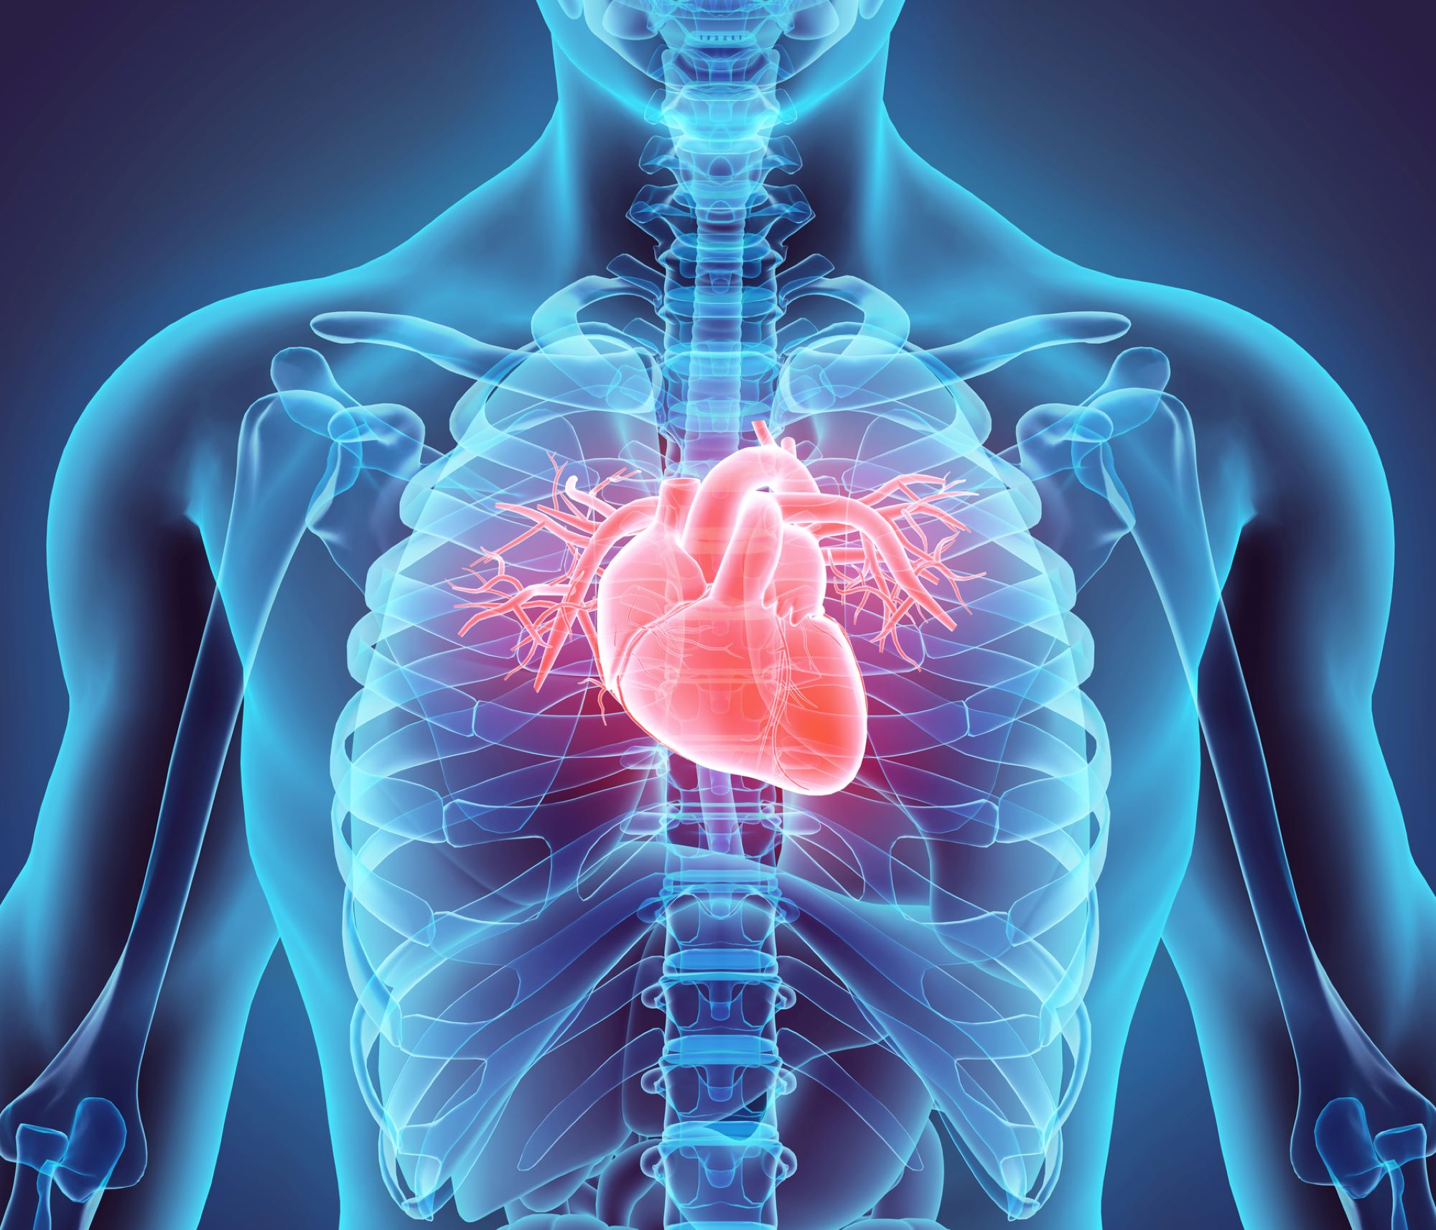
USING Machine learning classification of cardiovascular disease prediction

Slide 2

Submitted By:
Anasua Mazumdar
ID: 193-35-2905
Department of Software Engineering
Daffodil International university
Supervised By:
Mrs. Fatama Binta Rafiq
Senior Lecturer
Department of Software Engineering
Daffodil international university

Slide 3
Background
Heart disease is a major cause of death worldwide, with an estimated 17.9 million deaths in 2019 alone (WHO).
Early detection and prevention of heart disease is reducing mortality
Machine learning is a field of artificial intelligence that involves building algorithms that can learn from data and make predictions or decisions based on that data.
One of the challenges in heart disease prediction is the complexity of the risk factors involved, such as age, gender, family history, lifestyle habits, and medical history.
Machine learning can help to identify patterns and relationships in large and complex datasets.

Slide 4

Table of contents
Background
Motivation
Scope
Research Question
Literature Review
Methodology
Features Analysis and visualization
Overall model Accuracy

Slide 5
motivation
Heart disease is a leading cause of death worldwide, and early detection and prevention can significantly improve patient outcomes.
Traditional risk prediction models for heart disease have limitations, and machine learning offers a promising alternative for more accurate and efficient prediction.
Machine learning algorithms can help to identify high-risk patients and provide personalized preventive care, leading to better health outcomes and reduced healthcare costs.

Slide 6
scope
Predict accurately.
Heart disease prediction using machine learning involves analyzing patient data such as medical records, diagnostic test results, and lifestyle factors to generate predictions about an individual's risk of developing heart disease.
Machine learning algorithms can be used to develop predictive models that can identify high-risk patients and provide personalized care recommendations.
The scope of heart disease prediction using machine learning can also include the development of decision support systems that can assist healthcare providers in making informed treatment decisions.
.

Slide 7
Research Question
Does this model give maximum accuracy?
Can machine learning algorithms accurately predict an individual's risk of developing heart disease based on their medical history, lifestyle factors, and other risk factors?
How do machine learning algorithms compare to traditional risk prediction models in terms of accuracy and efficiency in predicting heart disease risk?
What are the most important risk factors for heart disease that should be considered in machine learning algorithms, and how can these factors be weighted appropriately?

Slide 8
Literature review
Serial number | Paper Name | Author Name | Publication year | method | source | Finding and Lacking
1 | Prediction of Heart Disease Using Machine Learning | Aditi Gavhane; Gouthami Kokkula; Isha Pandya; Kailas Devadkar | 2018 | KNN,DT,LR,NN,NB | https://ieeexplore.ieee.org/abstract/document/8474922/keywords#keywords | The Heart Disease Prediction System using Machine learning algorithm,viz. MLP provides its users with a prediction result that gives the state of a user leading to CAD.

Slide 9
Serial number | Paper name | Author name | Publication year | method | source | Finding and lacking
2 | A Method for Improving Prediction of Human Heart Disease Using Machine Learning Algorithms | Abdul Saboor,1Muhammad Usman ,1Sikandar Ali ,2Ali Samad ,3Muhmmad Faisal Abrar ,4and Najeeb Ullah | 2022 | Seven classification algorithms are used, which consist of NB, KNN, LR, DT, NN, SVM, and Vote. | https://www.hindawi.com/journals/misy/2022/1410169/ | machine learning to classify the prediction of heart disease, including an accuracy of 96.72% achieved by SVM.

Slide 10
Serial number | Paper name | Author name | Publication year | method | source | Finding and lacking
03 | PREDICTIVE ANALYSIS OF HEART DISEASES WITH MACHINE LEARNING APPROACHES | Ramesh TR, Umesh Kumar Lilhore, Poongodi M, Sarita Simaiya, Amandeep Kaur, Mounir Hamdi | 2022 | Heart Disease Health Care Machine Learning Naive Bayes Decision Tree Classifier SVM K-Nearest Neighbor Logistic Regression Random Forest | https://jpmm.um.edu.my/index.php/MJCS/article/view/35980 | Different machine learning algorithms such as decision trees, random forests, logistic regression, and support vector machines have been used for heart disease prediction.

Slide 11
Serial number | Paper name | Author name | Publication year | method | source | Finding and lacking
4 | Prediction of Coronary Heart Disease using Machine Learning: An Experimental Analysis | Amanda H. Gonsalves, Fadi Thabtah, Rami Mustafa A.Mohammd, Gurpreet Singh | 2019 | The authors used Support Vector Machine (SVM), Artificial Neural Network (ANN) and Decision Trees (DT) | https://dl.acm.org/doi/abs/10.1145/3342999.3343015?casa_token=YkiFnipDjy8AAAAA:zNArbZ7MwNPcmjuXH68wCZkS0DndQ6S0fWGUkjMmKs0zlI5wMO1BZ_bcWz7Sn1_0XEXGz13yaeZqLg | Lacking:Based on the obtained ML results from the CHD dataset, future research needs to be carried out to improve the performance of the model, especially to increase the Sensitivity and Specificity rates.

Slide 12
Serial number | Paper name | Author name | Publication year | method | source | Finding and lacking
5 | Prediction of Heart Disease Using Machine Learning | Aditi Gavhane Gouthami Kokkula, Isha Pandya , Prof. Kailas Devadkar (PhD) | 2018 | KNN, LR, DT, NN, SVM, | https://ieeexplore.ieee.org/document/8474922/keywords#keywords | the machine learning algorithms are evolved a lot and hence we use Multi Layered Perceptron (MLP) in the proposed system because of its efficiency and accuracy.

Slide 13
Serial number | Paper name | Author name | Publication year | method | source | Finding and lacking
6 | Analysing and improving the diagnosis of ischaemic heart disease with machine learning | Matjaz' Kukar a,Igor Kononenko a , Ciril Gros'elj b , Katarina Kralj a , Jure Fettich | 1998 | Here used following algorithms: the naive Bayesian classifier, back-propagation learning of neural networks, decision trees and k-nearest neighbours method. | https://www.sciencedirect.com/science/article/pii/S0933365798000633 | The increase of specificity and sensitivity of the myocardial scintigraphy by using the information from the evaluation of signs and symptoms and from the exercise ECG, is a significant result.

Slide 14
Serial number | Paper name | Author name | Publication year | method | source | Finding and lacking
7 | Prediction of Cardiovascular Disease Using Machine Learning Algorithms | Dinesh Kumar G, Santhosh Kumar D,Arumugaraj K, Mareeswari V | 2018 | Logistic Regression , Naive Bayes, Accuracy Module , Random Forest, Support Vector Machine , Gradient Boosting | https://ieeexplore.ieee.org/abstract/document/8550857/keywords#keywords | This paper contributes the correlative application and analysis of distinct machine learning algorithms in the R software

Slide 15
Serial number | Paper name | Author name | Publication year | method | source | Finding and lacking
8 | Prediction of Cardiac Disease using Supervised Machine Learning Algorithms | R.Jane Preetha Princy, Saravanan Parthasarathy, P. Subha Hency Jose, Arun Raj Lakshminarayanan , Selvaprabu Jeganathan | 2020 | Cardiovascular Disease, Naive Bayes, Decision Tree, Logistic Regression, Random Forest, SVM, KNN, Risk prediction | https://ieeexplore.ieee.org/abstract/document/9121169 | The Decision Tree algorithm delivered better prediction by providing 73% of accuracy. S

Slide 16
Serial number | Paper name | Author name | Publication year | method | source | Finding and lacking
9 | A Method for Improving Prediction of Human Heart Disease Using Machine Learning Algorithms | Abdul Saboor,1Muhammad Usman ,1Sikandar Ali ,2Ali Samad ,3Muhmmad Faisal Abrar ,4and Najeeb Ullah 4 | 2022 | the machine learning techniques (RF, CART, LDA, AB, LR, ET, and XGB) improved their accuracy, while MNB and SVM classifiers decreased their accuracy on the standardized dataset. | https://www.hindawi.com/journals/misy/2022/1410169/ | the ET and AB classifiers achieve the highest prediction accuracy of 90.16%. MNB shows the overall lowest performance and has the lowest accuracy of 59.01%.

Slide 17
Serial number | Paper name | Author name | Publication year | method | source | Finding and lacking
10 | A Comprehensive Investigation of the Performances of Different Machine Learning Classifiers with SMOTE-ENN Oversampling Technique and Hyperparameter Optimization for Imbalanced Heart Failure Dataset | Mirza Muntasir Nishat,1Fahim Faisal ,1Ishrak Jahan Ratul,1Abdullah Al-Monsur,1Abrar Mohammad Ar-Rafi,1Sarker Mohammad Nasrullah,2Md TasKhan1 | 2022 | Decision Tree Classifier, Logistic Regression, Gaussian Naïve Bayes, Random Forest Classifier, K-Nearest Neighbors, and Support Vector Machine algorithms. | https://www.hindawi.com/journals/sp/2022/3649406/ | SMOTE-ENN and hyperparameter optimization have played a significant role in enhancing the performances of the classifiers. Approach C has the best test accuracy of 90%

Slide 18
Serial number | Paper name | Author name | Publication year | method | source | Finding and lacking
11 | Heart Failure Detection Using Quantum-Enhanced Machine Learning and Traditional Machine Learning Techniques for Internet of Artificially Intelligent Medical Things | Yogesh Kumar ,1Apeksha Koul,2Pushpendra Singh Sisodia,1Jana Shafi ,3Kavita Verma,4Mehdi Gheisari ,5and Mohamad Bagher Davoodi6 | 2021 | quantum random forest (QRF), quantum nearest neighbour (QKNN), quantum decision tree (QDT), and quantum Gaussian Naïve Bayes (QGNB) | https://www.hindawi.com/journals/wcmc/2021/1616725/ | quantum-enhanced sampling and discrete optimization.

Slide 19
Serial number | Paper name | Author name | Publication year | method | souce | Finding and lacking
12 | Automated Cardioailment Identification and Prevention by Hybrid Machine Learning Models | K. S. Archana,1B. Sivakumar,2Ramya Kuppusamy ,3Yuvaraja Teekaraman ,4and Arun Radhakrishnan | 2022 | Naive Bayes Classifier, Random Forest Classifier, Evaluation Matrices, Modified Naive Bayes and Random Forests | https://www.hindawi.com/journals/cmmm/2022/9797844/ | this proposed method achieved 92% accuracy compared to other existing methods.

Slide 20
Serial number | Paper name | Author name | Publication year | method | source | Finding and lacking
13 | A Machine Learning in Binary and Multiclassification Results on Imbalanced Heart Disease Data Stream | Danish Hamid,1Syed Sajid Ullah,2,3Jawaid Iqbal,1Saddam Hussain ,4Ch. Anwar ul Hassan ,1and Fazlullah Umar | 2022 | Decision Tree, Random Forest, Gradient Boosting Tree, Linear Support Vector Classifier, One-vs-Rest, Logistic Regression, Multilayer Perceptron | https://www.hindawi.com/journals/js/2022/8400622/ | For binary classification, the classification algorithms, random forest, logistic regression, GBT, linear SVC, and multilayer perceptron, provide high accuracy scores

Slide 21
Serial number | Paper name | Author name | Publication year | method | source | Finding and lacking
14 | Supervised Machine Learning-Based Cardiovascular Disease Analysis and Prediction | M. D. Amzad Hossen ,1Tahia Tazin ,1Sumiaya Khan ,1Evan Alam ,1Hossain Ahmed Sojib ,1Mohammad Monirujjaman Khan ,1and Abdulmajeed Alsufyani | 2021 | K-Nearest Neighbor (KNN) algorithm, DT, Genetic Algorithm (GA), and the Naive Bayes (NB) algorithm | https://www.hindawi.com/journals/mpe/2021/1792201/ | The logistic regression technique outperformed the other two classifiers employed, with an accuracy of 92%.

Slide 22
Serial number | Paper name | Author name | Publication year | method | source | Finding and lacking
15 | An Image Processing Approach for Detection of Prenatal Heart Disease | Saravana Selvan,1S. John Justin Thangaraj,2J. Samson Isaac,3T. Benil,4K. Muthulakshmi,5Hesham S. Almoallim,6Sulaiman Ali Alharbi,7R. R. Kumar,8and Sojan Palukaran Thimothy | 2022 | Naive Bayes,k -nearest neighbor, random forest, and decision tree were the four data mining categorization algorithms | https://www.hindawi.com/journals/bmri/2022/2003184/ | naive Bayes classifier outperforms methodological approaches with a reliability rate of 97 percent and a precision rate of 94 percent.

Slide 23
overall literature review
Several studies have shown that machine learning techniques can be used to predict heart disease. For instance, in a study by Rajendra et al. (2019), the authors developed a heart disease prediction model using artificial neural networks (ANNs). The study found that the ANN model was able to predict heart disease with an accuracy of 94.44%.
In another study by Kavakiotis et al. (2017), the authors developed a machine learning model using data from electronic health records. The study found that the model was able to predict heart disease with an accuracy of 80%.
In addition, several studies have focused on identifying the risk factors associated with heart disease. For instance, a study by Mollalo et al. (2020) identified several risk factors for heart disease, including age, hypertension, diabetes, and smoking.
Moreover, several studies have examined the use of different machine learning algorithms for heart disease prediction. For example, a study by Qureshi et al. (2020) compared the performance of different machine learning algorithms, including decision trees, random forests, and support vector machines, for heart disease prediction. The study found that the random forest algorithm had the highest accuracy for heart disease prediction.

Slide 24

Methodology
In Research field there are two type of method--
Qualitative: Qualitative research is the process of collecting, analyzing and interpreting non numerical data such as image , questionnaire, interview etc.
Quantitative: Quantitative research is referred to as the process of collecting as analyzing numerical data.
It’s a Quantitative Research based on analyzing and prediction using Machine Learning approaches

Slide 25
I would like to apply Supervised classification algorithms such as:
Logistic Regression
Naïve Bayes
Random Forest
Extreme Gradient Boost
K-Nearest Neighbor
Decision Tree
Support Vector Machine
Light GBM classifier

Slide 26
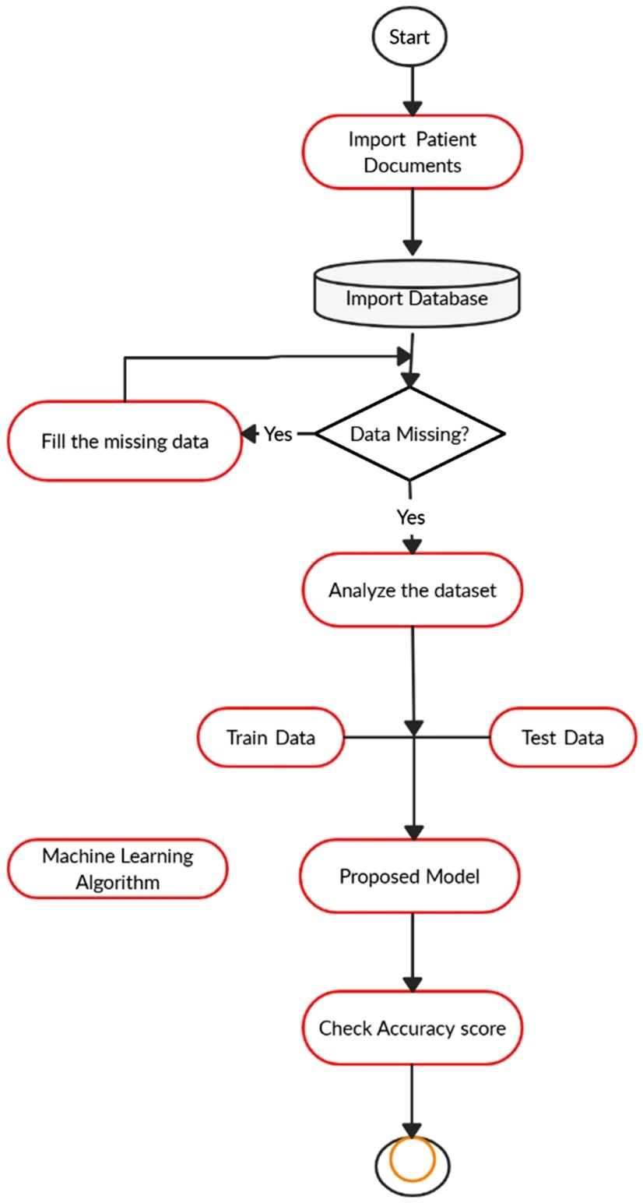
Sequential chart of proposed model

Slide 27
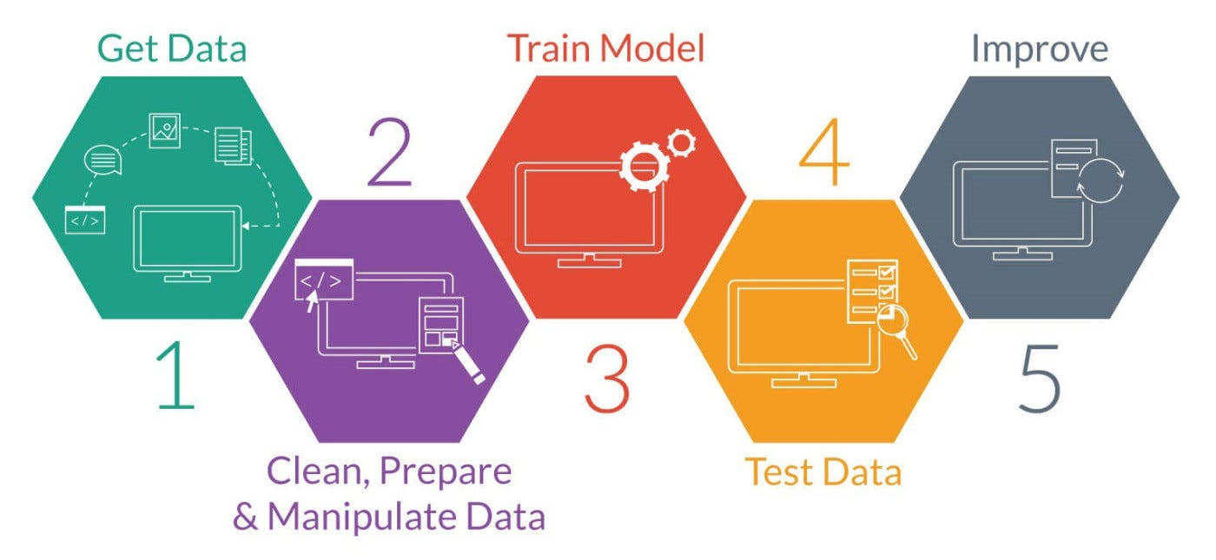
DATA PRE-PROCESSING

Slide 28
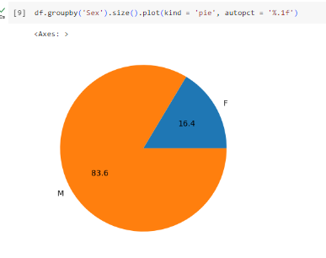
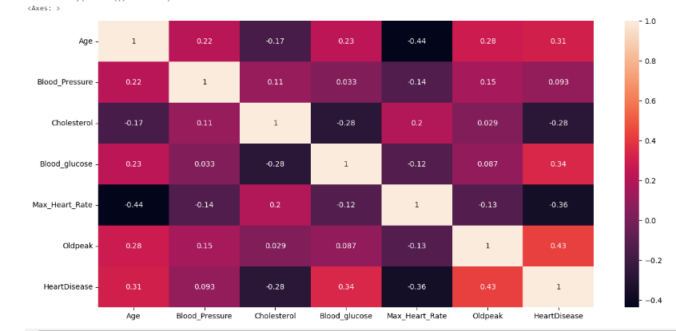
Features Analysis and visualization
Cardiovascular disease by Sex
Correlation of heat map

Slide 29
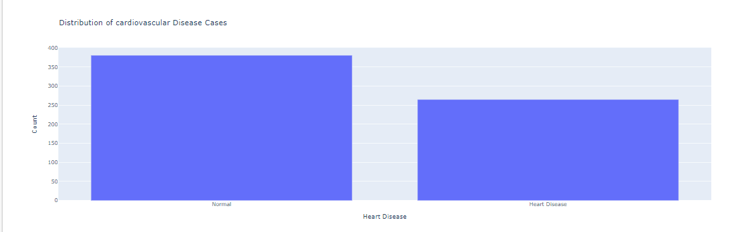
Distribution of cardiovascular disease

Slide 30
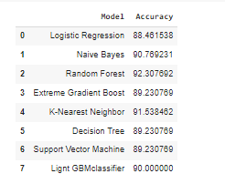
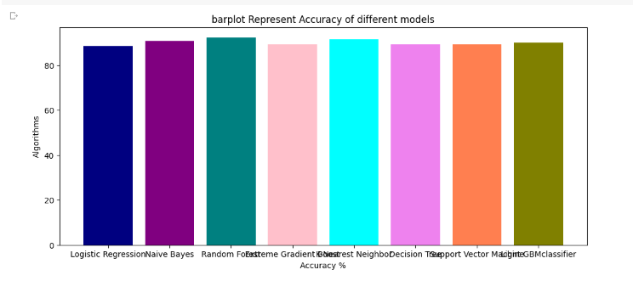
Overall model accuracy

Slide 31
Conclusion
Using classification approaches, this study was conducted on a cardiovascular dataset. The Random Forest method performed better in terms of prediction, with 92% accuracy.

Slide 32
References
[1] S. Bashir, Z. S. Khan, F. H. Khan, A. Anjum, and K. Bashir, ―Improving Heart Disease Prediction Using Feature Selection Approaches,‖ in 16th International Bhurban Conference on Applied Sciences and Technology (IBCAST), 2019, pp. 619–623
[2]H. DW Jr, L. S, and S. RX, Applied Logistic Regression, 3rd ed. New Jersey: John Wiley & Sons, 2013.
[3]N. Donges, ―The Random Forest Algorithm,‖ Towards Data Science, 2018.
[4] S. S. Bashar, M. S. Miah, A. H. M. Z. Karim, A. Al Mahmud, and Z. Hasan, ―A Machine Learning Approach for Heart Rate Estimation from PPG Signal using Random Forest Regression Algorithm,‖ in 2019 International Conference on Electrical, Computer and Communication Engineering (ECCE), 2019, pp. 1–5.
[5] V. Vapnik, Statistical Learning Theory. New York: Wiley, 1998.
[6] P. Tabesh, G. Lim, S. Khator, and C. Dacso, ―A support vector machine approach for predicting heart conditions,‖ in Proceedings of the 2010 Industrial Engineering Research Conference, 2010, p. 5.
[7] K. M, S. F, Z. Z, and P. N, ―Predicting MOOC dropout over weeks using machine learning methods,‖ in Proceedings of the EMNLP 2014 Workshop on Analysis of Large Scale Social Interaction in MOOCs, aclweb.org, 2014, pp. 60–65.
[8] https://machinelearningmastery.com/light-gradient-boosted-machine-lightgbm-ensemble/

Slide 33
THANK YOU

